Slide 1
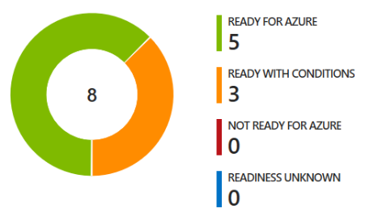














2
3
1
Azure Migrate: Server Assessment Data Migration Assistant (DMA)
UbuntuWAF
Migration: Azure Firewall
SmartHotelWAF
SmartHotelWeb1
SmartHotel On-premises
SmartHotelWeb1
SmartHotel Azure
SmartHotelHost
Azure Migrate: Server Migration
SmartHotelWeb2
SmartHotelWeb2
Azure Database Migration Service
SmartHotelSQL1
SmartHotelDB

Slide 2

Deploy to Azure

